Slide 1



FOCUS
Student Productivity & AI Study Assistant.
Presented by
﻿N. Jagadish & Team

Slide 2


Challenges Students Face
Understanding their daily struggles
Many students face heavy workloads, tight deadlines, and constant distractions, which reduce productivity and increase stress.
Finding an efficient and organized study method is essential for academic success.

Slide 3
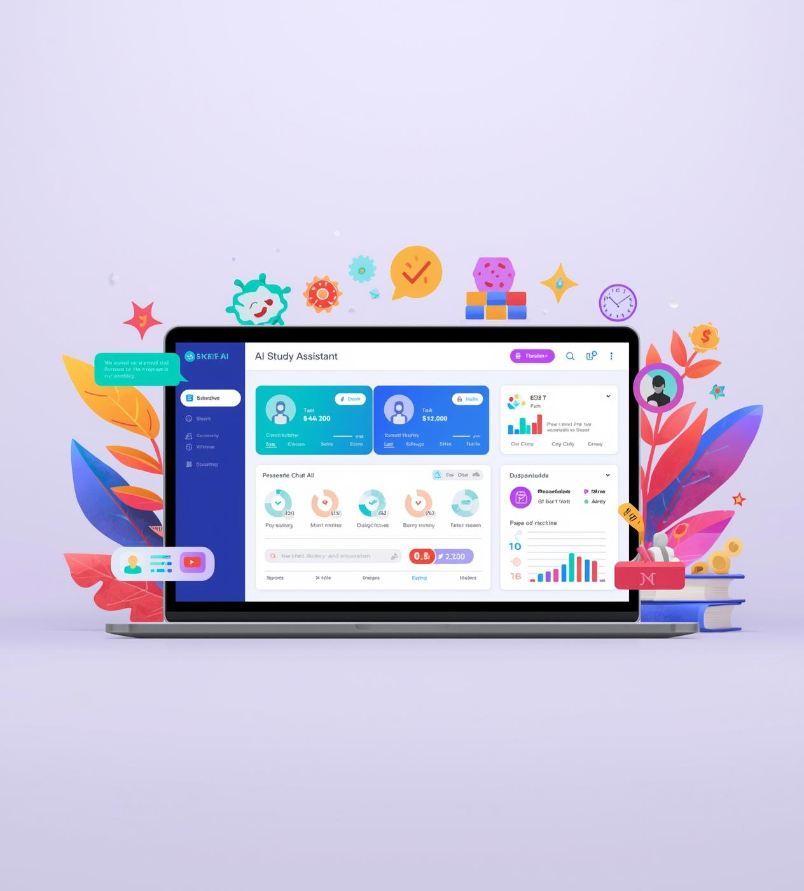
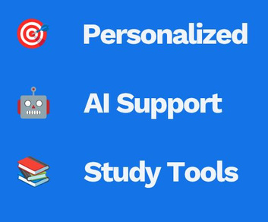
Our Solution
AI-Powered Study Assistance Tool
Our AI-powered assistant helps students improve productivity by offering personalized study plans, real-time support, and smart tools designed to simplify learning and boost outcomes.

Slide 4

Key Features
Focus Timer for Enhanced Productivity
Daily Planner for Better Organization
Plan your day effectively to improve study efficiency.
Stay on track with dedicated study sessions.
AI Study Tools for Personalized Learning
Calendar & Tasks for Effective Time Management
Use AI to scan text, answer questions, summarize files, and generate timetables.
Track deadlines and manage assignments effortlessly.

Slide 5
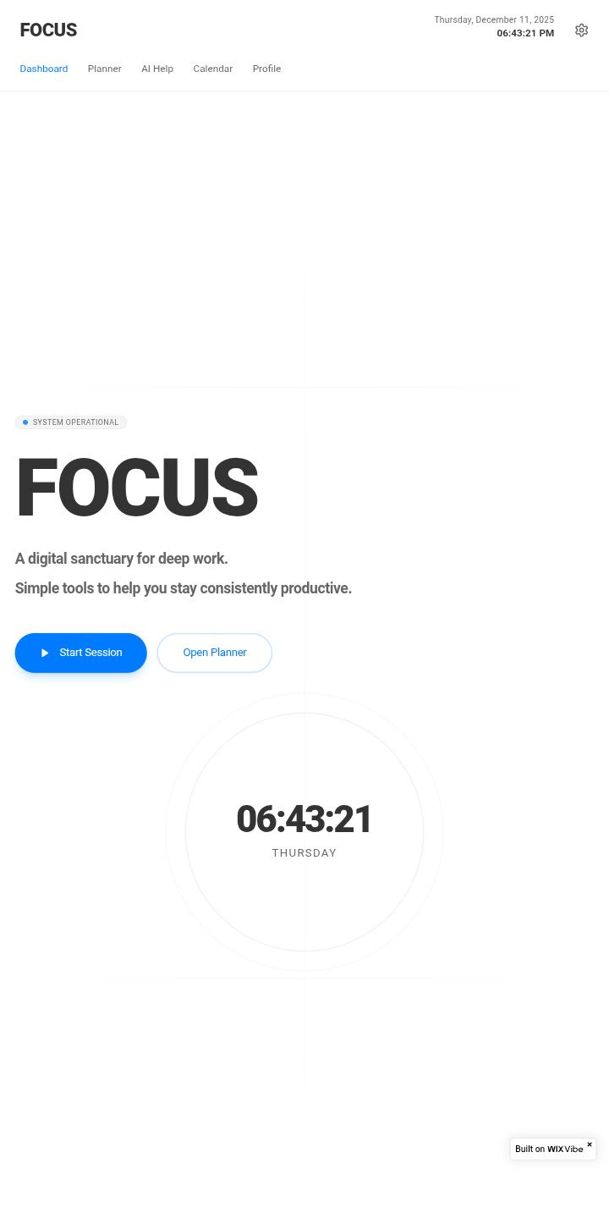
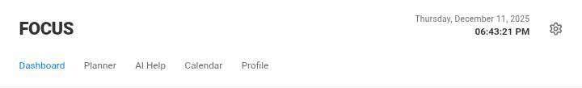
Homepage
The FOCUS homepage is designed with a clean and user-friendly interface that makes navigation easy.
Bright visuals and intuitive layout help students quickly access study tools, manage tasks, and track progress — creating a smooth and effective study experience.

Slide 6
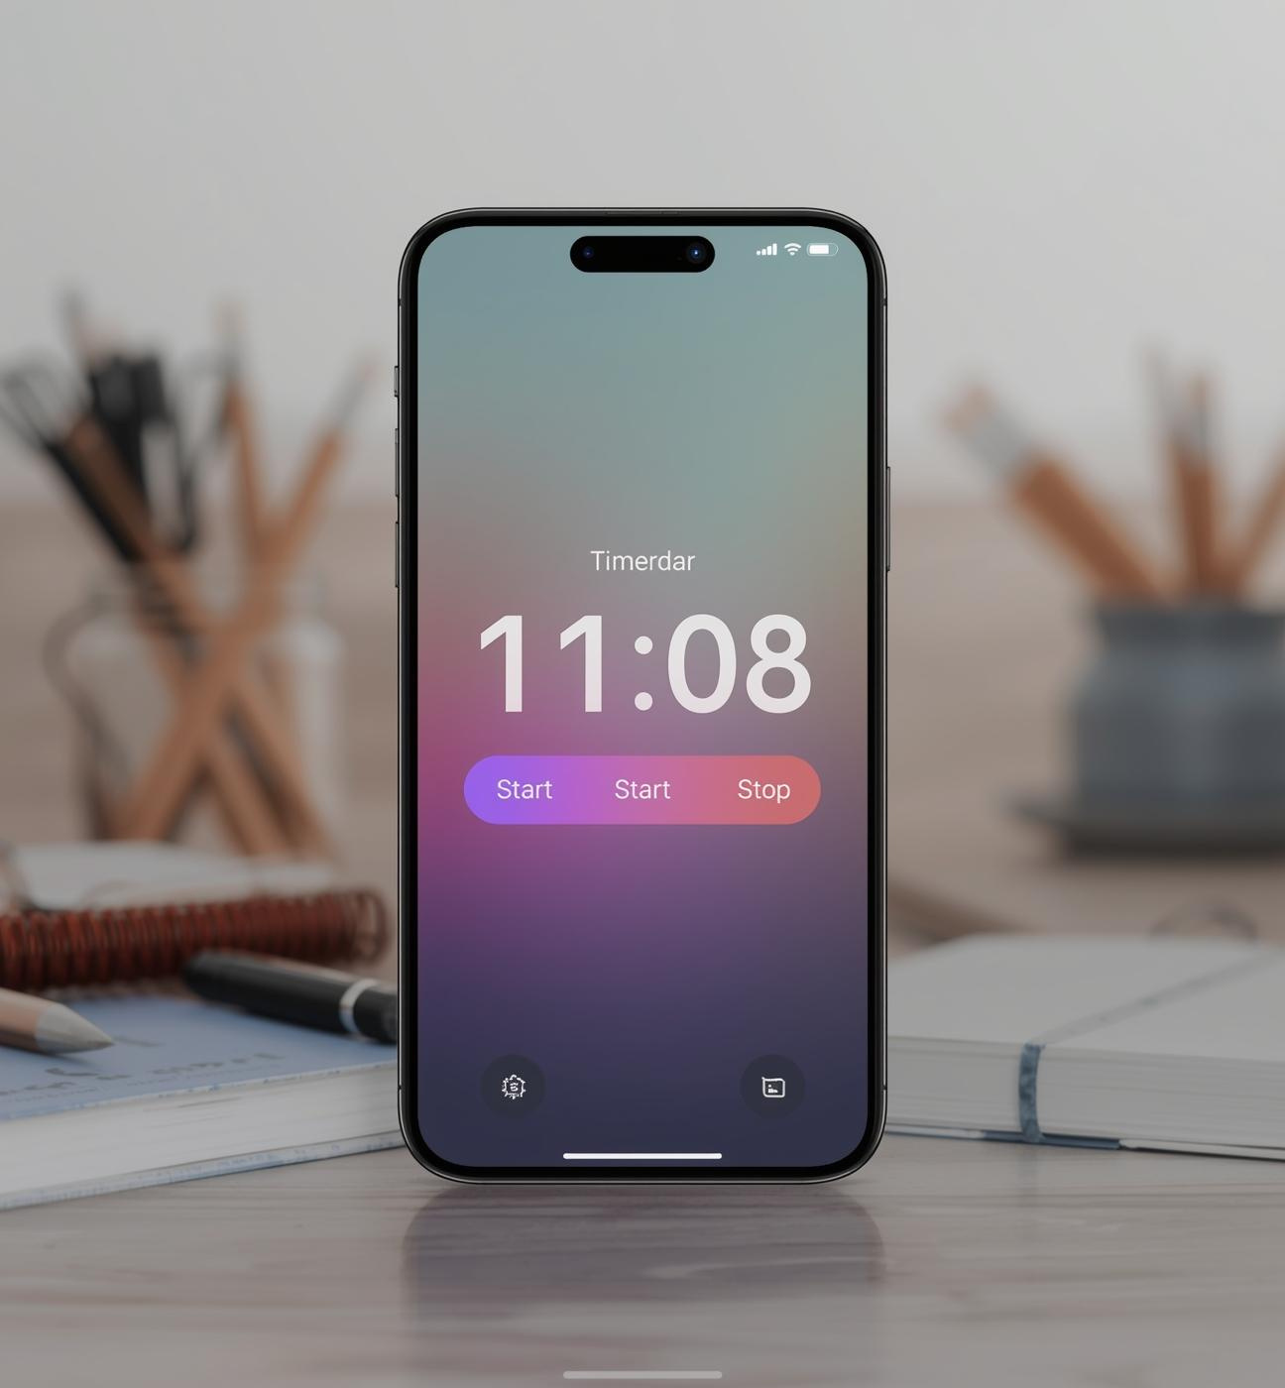
Focus Timer
The Focus Timer boosts productivity by helping students manage their study time effectively.
With customizable session durations and breaks, it creates a structured study flow that reduces distractions and improves focus — leading to better academic performance.

Slide 7
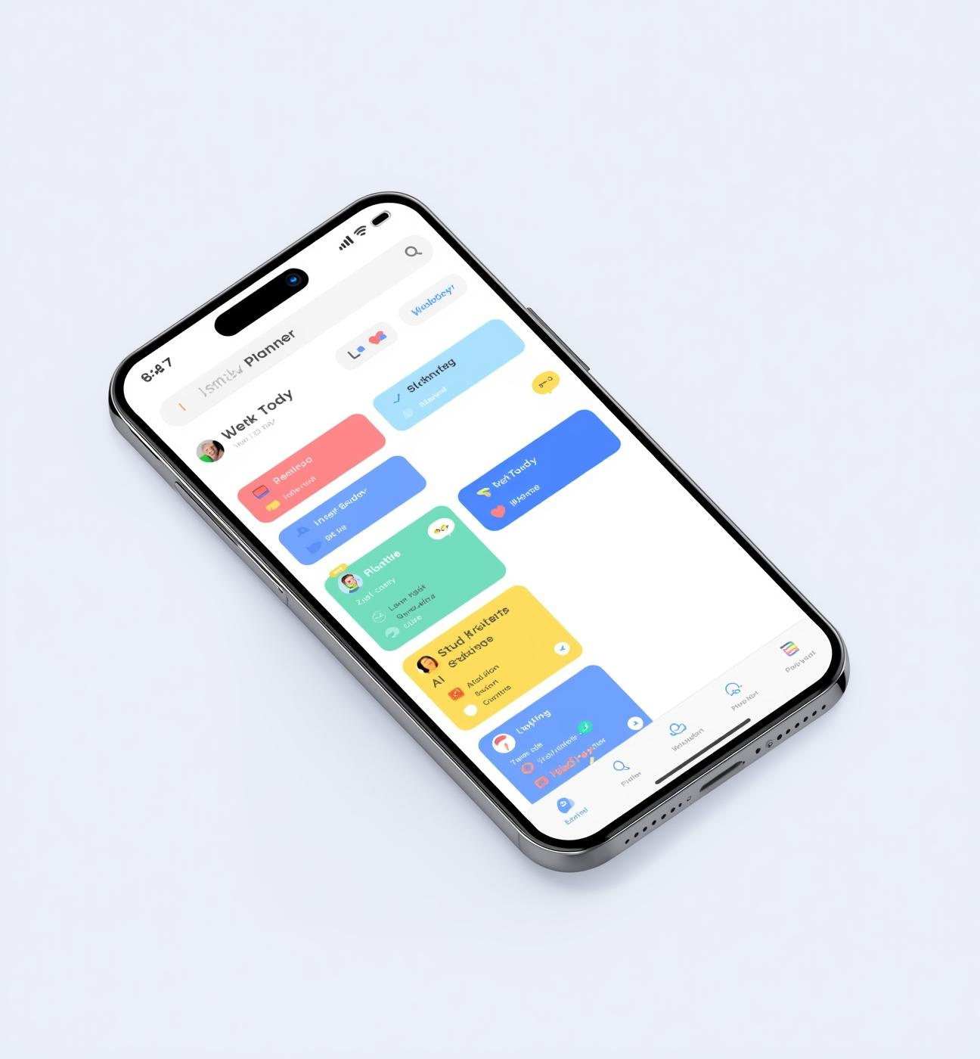
Daily Planner
The Daily Planner helps students manage their time effectively.
With a clean and intuitive layout, it allows users to schedule study sessions, assignments, and breaks with ease — keeping them organized and focused throughout the day for improved productivity.

Slide 8

AI Tools
Our AI Study Tools enhance learning by offering personalized resources, smart recommendations, and interactive study features. These tools help students understand complex concepts, optimize study time, and track their progress in a user-friendly environment tailored to their learning needs.

Slide 9
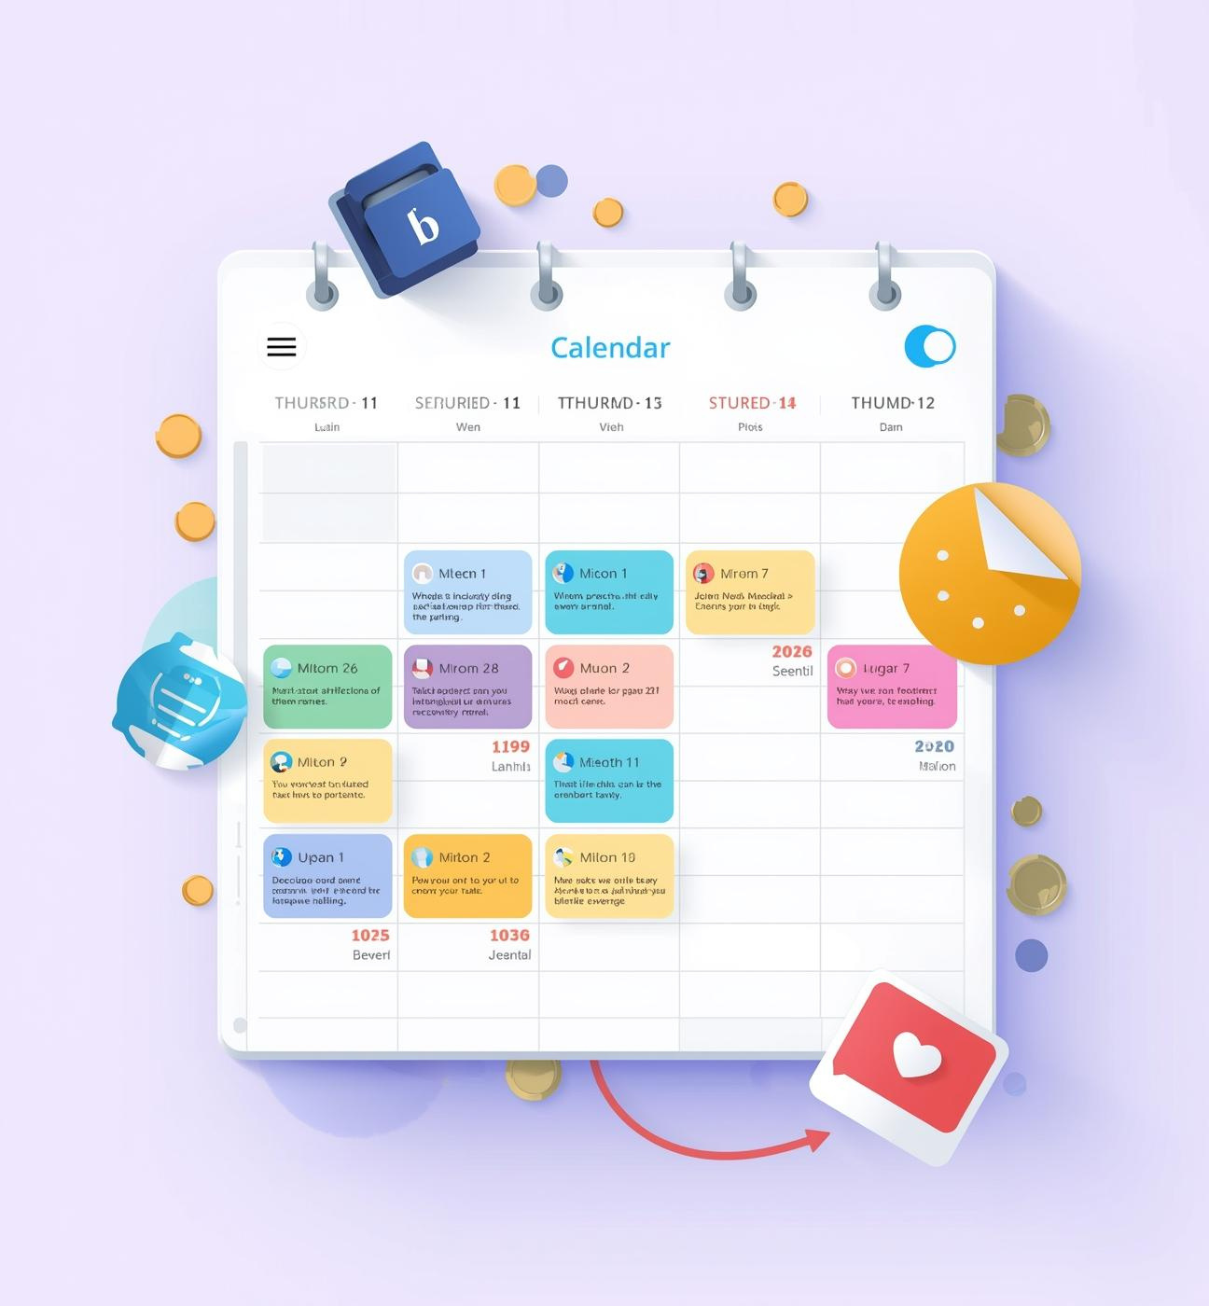
Calendar & Tasks
The Calendar & Tasks feature helps students manage their schedules, deadlines, and events with ease. The intuitive interface allows users to organize tasks, set reminders, and prioritize their studies, ensuring a productive and personalized academic experience.

Slide 10
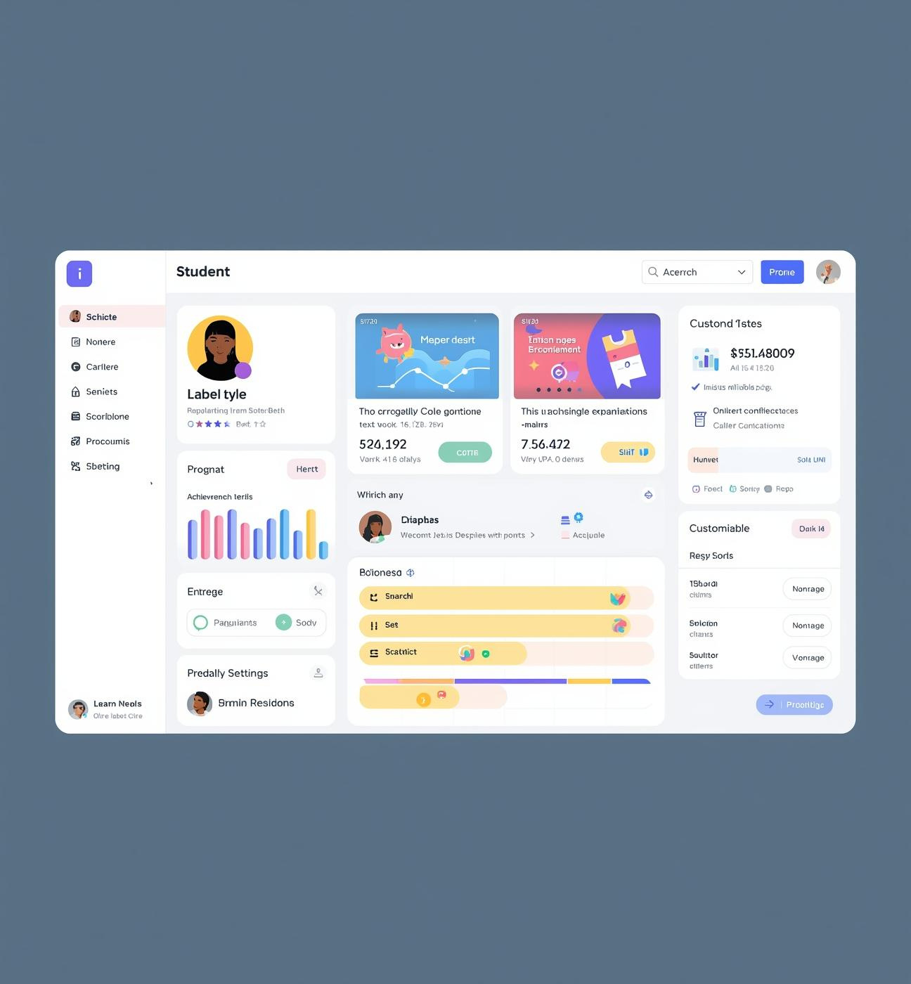
Profile
The Profile Page provides students with a personalized dashboard showing their study progress, XP level, streaks, completed sessions, and achievements. The XP Level and Streaks system motivates users to stay consistent by tracking goals and offering insights based on their study habits.

Slide 11

Methodology
Research Approach and Data Collection
Our research followed a mixed-methods approach, combining quantitative surveys with qualitative interviews. This allowed us to gather comprehensive insights into student productivity and their need for AI-driven study support.

Slide 12

Why This Project Matters
Students struggle with distractions, poor planning, and inconsistent study routines.
Our project provides simple digital tools to help them stay organized, focused, and motivated.
It encourages better study habits through timers, planners, calendars, and streak-based progress.

Slide 13

Project Links
Below are the main resources for our FOCUS project.
These links provide access to the live website and the GitHub repository containing all project files and documentation.
🔗 Live Website:
https://coxx6j-my-site-1vp0llef-jagadish3506.wix-vibe.com/
🔗 GitHub Repository:
https://github.com/jagadish3506/focus-rest-hub

Slide 14

Team Members
S. Prabhas
B. Tarun Kumar
D. Vamshi
N. Jagadish
P. Shashank
Thank You

